Slide 1



Slide 2


📊Project Title :Blinkit Sales Data Analysis
Name: Indranil Mukherjee
College Name: Narula Institute of Technology
Department: Information Technology
📞 Contact Us
📱 Phone: 8981838547
🌐 Website: https://classroomtech.in
🔗 LinkedIn: https://www.linkedin.com/company/classroom-tech/
Duration: 3 months 1st April 2025 to 30th June 2025

Slide 3
Table of Contents
1
Objective
Goal of the project and key analytical questions
6
Key Findings
3–5 headline insights distilled from the analysis
2
Dataset Overview
Data source, size, and key fields used in analysis
Conclusion
Lessons learned and how the insights support
decision‑making
7
3
Tools Used
Power BI, GitHub
8
GitHub Link
URL to code, Power BI file, and datasets
Methodology
Data‑cleaning steps and the rationale behind chosen visualizations
4
9
Thank You
5
Visualizations & Insights
Individual charts with purpose and key takeaways

Slide 4
Objective / Problem Statement
Goal: To analyze Blink IT's customer, delivery, inventory, and marketing data using Power BI, and generate actionable insights that can improve customer experience, delivery performance, inventory management, and campaign effectiveness.
Key Objectives:
Identify loyal customers and analyze order patterns
Measure delivery delays and performance
Track product demand and stock levels
Evaluate marketing campaigns based on ROAS
Understand customer feedback and satisfaction
Forecast future inventory needs

Slide 5
Dataset Overview
Dataset Name: Blinkit Sales Dataset
Source: Kaggle : https://www.kaggle.com/datasets/akxiit/blinkit-sales-dataset
5. blinkit_inventoryNew.csv
Shape: 1,500 rows × 5 columns
Key Columns:
product_id
damaged_percentage
Used for: Analyzing damaged stock rates
6. blinkit_marketing_performance.csv
Shape: 300 rows × 6 columns
Key Columns:
campaign_id, campaign_name
spend, revenue_generated, ROAS
Used for: Evaluating campaign effectiveness
7. blinkit_order_items.csv
Shape: 50,000 rows × 4 columns
Key Columns:
order_id, product_id
quantity, price
Used for: Product-level sales analysis
8. blinkit_orders.csv
Shape: 20,000 rows × 5 columns
Key Columns:
order_id, customer_id
order_date, store_id, delivery_status
Used for: Order volume and trends
1. blinkit_customer_feedback.csv
Shape: 5,000 rows × 3 columns
Key Columns:
Customer_id
feedback_category
feedback_text
Used for: Analyzing customer complaints & satisfaction
2. blinkit_customers.csv
Shape: 10,000 rows × 5 columns
Key Columns:
customer_id
customer_name
address, phone, email
Used for: Customer segmentation, location-based trends
3. blinkit_delivery_performance.csv
Shape: 15,000 rows × 4 columns
Key Columns:
order_id
delivery_time_minutes
delivery_delay_minutes
delivery_status
Used for: Measuring delivery efficiency and delay.
4. blinkit_inventory.csv
Shape: 1,500 rows × 4 columns
Key Columns:
product_id
stock_received
month, year
Used for: Stock movement over time
9. blinkit_products.csv
Shape: 1,000 rows × 5 columns
Key Columns:
product_id, product_name
category, price, discount_percentage
Used for: Product and pricing analytics
10. Category_Icons.xlsx
Shape: ~20 rows × 2 columns
Key Columns:
category, icon_url
Used for: Dashboard visuals and category mapping

Slide 6
Tools Used
Methodology
Power BI – Used for building interactive dashboards, visual reports, and deriving business insights
GitHub – Utilized for version control and hosting project files, datasets, and final reports
Data Preprocessing:
The. dataset from Kaggle was already well-structured and cleaned. No major missing values or outliers were found during initial inspection Basic validation was done to ensure consistency across files (e.g., matching product_id, order_id, and customer_id across tables).
Visualization Process:
Power BI was used to create interactive dashboards and visualizations including:
Bar Charts for order counts, product sales, and feedback distribution
Line Charts and Time Series for monthly trends and stock forecasts
Donut Charts for customer segments and feedback categories
KPI Cards to highlight revenue, customer retention, and order value
Funnel Charts and Decomposition Trees to track campaign performance and segment insights

Slide 7
Slide 7: Key Findings
Top insights uncovered from the Power BI analysis of BlinkIT’s data:
Seasonal Order Trends Observed Order volume peaked notably in August and May, indicating a strong seasonal pattern that can inform demand forecasting and stocking plans..
Delivery Efficiency Is Good, but Delay Rates Need Focus While 70% of deliveries met promised times, about 30% were delayed, revealing scope for enhancing route planning and delivery slot management.
Frequent Product Damages Identified Items like cleaning agents and detergents showed damage rates exceeding 20%, highlighting issues in transport handling or packaging quality.
Marketing ROI Shows Mixed Results Campaigns such as Referral Schemes and Festive Discounts achieved strong ROAS (above 3.8), while others underperformed — indicating a need for better campaign targeting and budget alignment..
Top Customers Hold High Lifetime Value Customers like Aadhya Cherian have CLV exceeding ₹28,000, suggesting opportunities for exclusive offers, loyalty programs, and enhanced retention strategies.

Slide 8
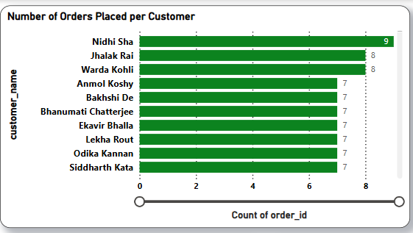
1️⃣ Number of Orders Placed per Customer
Purpose: To identify our most active customers by tracking how many orders each has placed.
Visual: Horizontal bar chart
Y-axis: Customer names ,X-axis: Number of orders placed, Green bars represent the order counts, with values shown at each bar’s end
Insights:
Nidhi Sha stands out as the top customer with 9 orders, reflecting exceptional engagement.
Several other customers placed between 7 and 8 orders, indicating strong patterns of repeat purchases among multiple buyers.
These insights highlight an opportunity to strengthen relationships with frequent shoppers through targeted incentives, personalized offers, and retention strategies.

Slide 9
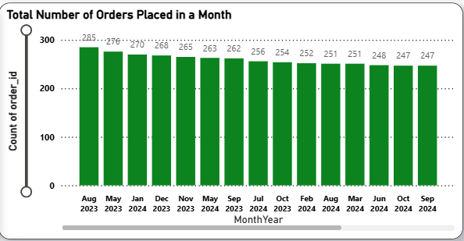
2️⃣ Total Number of Orders Placed in a Month
Purpose: Track monthly order trends to understand customer activity.
Visual: Vertical bar chart (X-axis: Month-Year, Y-axis: total orders)
Insights:
August 2023 (285 orders) and May 2023 (276 orders) are peak months.
. Order volumes are generally stable month to month.
Useful for planning promotions, staffing, and inventory.

Slide 10
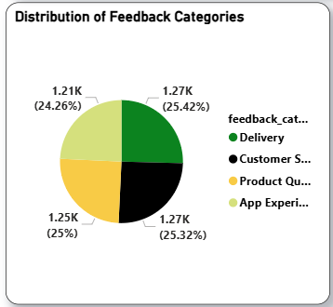
3️⃣ Distribution of Feedback Categories
Purpose: Identify which aspects of service receive the most customer feedback.
Visual: Pie chart comparing four categories: Delivery, Customer Service, Product Quality, App Experience.
Insights:
Feedback is split almost equally among all categories (about 24–25% each).
No single issue stands out—improvement is needed across the board.
Suggests every team should work together for a better overall customer experience.

Slide 11
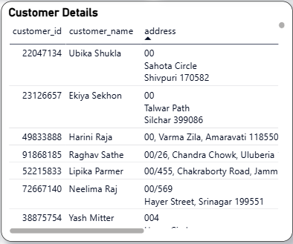
4️⃣ Customer Details
Purpose: To view basic details about individual customers.
Visual: Table with customer ID, name, and address.
Insights:
Supports address validation for deliveries.
Useful for store or zone-level order tracking.
Can be used for personalized service and communication.

Slide 12
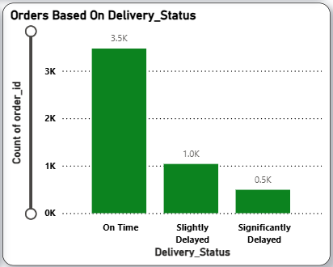
5️⃣ Orders Based on Delivery Status
Purpose
Show the count of orders delivered on time, slightly delayed, and significantly delayed.
Visual
Vertical bar chart
X-axis: Delivery Status
Y-axis: Number of Orders
Insights
3,500 orders arrived on schedule, 1,000 had minor delays, and 500 were heavily delayed.
The majority of orders—over 70%—were delivered when promised.
Process improvements can target delays to boost timely deliveries even further.

Slide 13
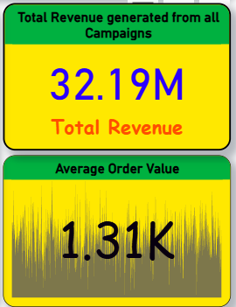
6️⃣ Average Order Value (AOV)
Purpose: Typical value per customer order.
Visual: KPI card — 1.31K (currency implied).
Insights:
Each order averages 1,310 units.
Useful for monitoring customer spending habits.
Informs upselling and bundle offer tactics.
7️⃣ Total Revenue from Campaigns
Purpose:
Combined sales from all marketing efforts.
Visual:
KPI card — 32.19M total revenue.
Insights
Reflects total sales generated by ads.
Demonstrates the impact of App Push Notifications.
Supports marketing ROI and budget justification.

Slide 14
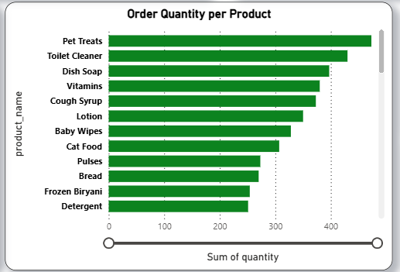
8️⃣Order Quantity per Product
Purpose: To see which products sell the most by volume.
Visual: Horizontal bar chart by product and quantity.
Insights:
Pet Treats, Dish Soap lead in quantity sold.
Guides restocking priorities.
Shows top revenue drivers.

Slide 15
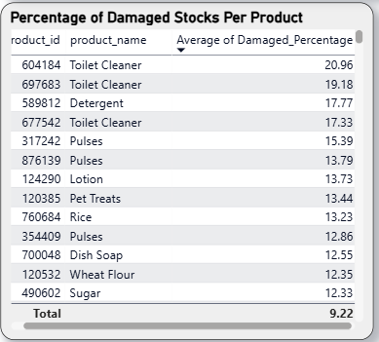
9️⃣Percentage of Damaged Stocks Per Product
Purpose: . Spot products with the highest damage rates.
Visual: Table lists product names, IDs, and average damage percentage.
Insights:
Toilet Cleaner and Detergent have the most damaged stock.
Stronger packaging is needed to cut losses.
Lower damage helps protect profits.

Slide 16
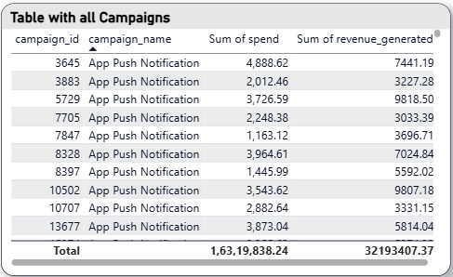
🔟 Campaign Table
Purpose
Compare individual marketing campaigns by how much was spent and how much revenue they generated.
Visual
Table detailing: campaign ID, name, total spend, and total revenue.
Insights
Spend per campaign ranges from about 1,000 to 5,000 units.
Most campaigns deliver more revenue than their spend.
Makes it easy to measure ROI and improve how marketing budgets are assigned.

Slide 17
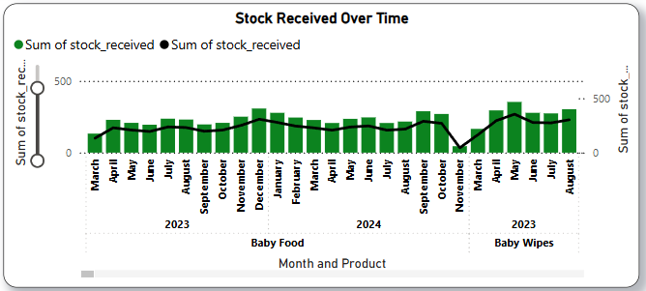
1️⃣1️⃣ Stock Received Over Time
Purpose: To track how much stock is received each month.
Visual: Line and column chart by month and product.
Insights:
Stock peaks in march-august.
Helps with demand forecasting.
Ensures stock levels match sales needs.

Slide 18
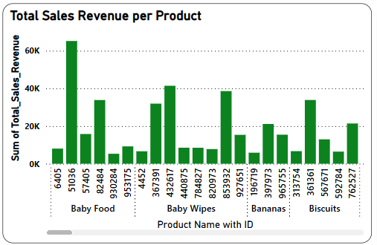
1️⃣2️⃣ Total Sales Revenue per Product
Purpose
Show which products bring in the most revenue
Visual
Vertical bar chart — X-axis: Product with ID, Y-axis: Total Sales Revenue.
Insights
Baby Food and Baby Wipes lead in total revenue.
Bananas and Biscuits are also strong sellers.
Useful for managers to prioritize top products for promotions and inventory planning.

Slide 19
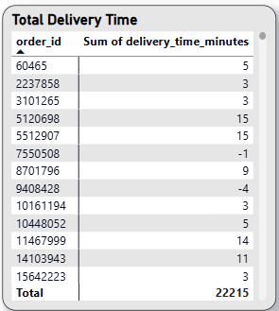

1️⃣3️⃣ Total Delivery Time
Purpose: Show delivery times (in minutes) for each order.
Visual: Table with order IDs and their corresponding delivery times.
Insights:
Most orders are delivered within 3–15 minutes.
A few entries have zero or negative times, pointing to possible data entry issues.
Helpful for tracking delivery performance and identifying data that needs correction.

Slide 20
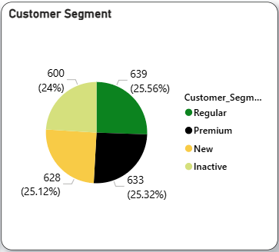
1️⃣4️⃣ Customer Segment
Purpose: Show the share of customers in each group.
Visual: Pie chart with segments: Regular, Premium, New, and Inactive.
Insights:
Each segment makes up about 24–25% of customers.
Customer base is well balanced across loyal, new, and inactive groups.
Useful for targeting tailored offers—especially to win back inactive users.

Slide 21
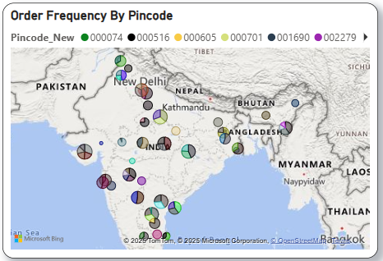
1️⃣5️⃣ Order Frequency by Pincode
Purpose: Illustrate the geographical origins of orders.
Visual:
Map with pin markers representing order locations by pincode. Insights:
Order activity clusters in certain states, revealing high-demand areas.
Helps decide where to set up delivery hubs or target for business expansion.
Informs localized marketing efforts to boost regional sales

Slide 22
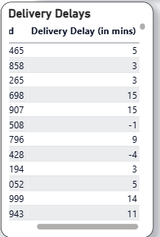
1️⃣6️⃣ Delivery Delays
Purpose: To display delivery delays for each order.
Visual: Table with order_id and Delivery Delay (mins).
Insights:
Most delays are under 15 mins.
Some negative values highlight possible data corrections needed.
Supports logistics performance tracking.

Slide 23
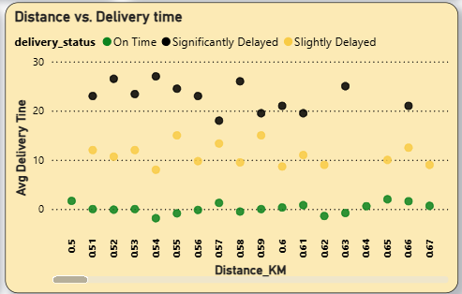
1️⃣7️⃣ Distance vs Delivery Time
Purpose:
Show how delivery time varies with distance. Visual: Scatter plot: X-axis is distance (KM), Y-axis is average delivery time, with points colored by delivery status.
Insights:
Slight upward trend: deliveries take longer as distance increases.
Easy to see which orders are On Time, Slightly Delayed, or Significantly Delayed.
Useful for planning faster, more efficient delivery routes.

Slide 24
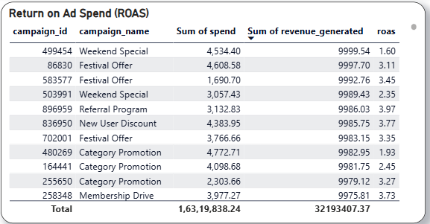
1️⃣8️⃣ Return on Ad Spend (ROAS)
Purpose: Assess which marketing campaigns deliver the best returns based on ad spend effectiveness.
Visual:
Table comparing: campaign ID, name, ad spend, revenue generated, and ROAS (return on ad spend). Insights:
Top performers: New User Discount (ROAS 3.77), Festival Offer (3.45), and Referral Program (3.19).
Most campaigns earn back more than their cost.
Helps shift budget to the campaigns delivering the strongest returns.

Slide 25
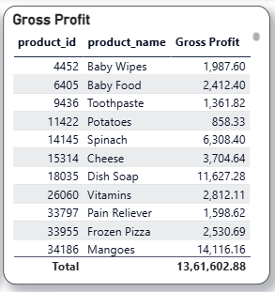
1️⃣9️⃣ Gross Profit by Product
Purpose: Highlight which products deliver the most gross profit.
Visual: Table lists: product ID, product name, and gross profit (₹).
Insights:
Mangoes lead in gross profit (₹14,116), with Dish Soap, Spinach, and Cheese as other big contributors.
Baby Wipes and Baby Food remain solid profit earners.
This focus helps drive buying and promotion of the most lucrative items.

Slide 26
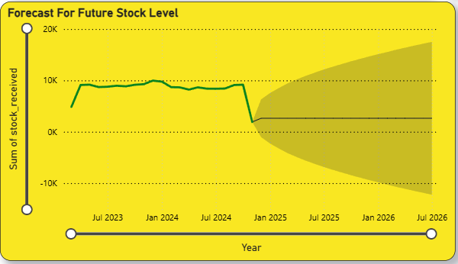
2️⃣0️⃣ Forecast for Future Stock Level
Purpose: Forecast future stock levels based on historical data.
Visual: FLine chart with a shaded forecast showing trends from 2023 to 2026.
Insights:
Stock levels are expected to decline rapidly after 2024.
Risk of stockouts if steps aren’t taken to replenish inventory.
Urgent need for inventory planning for 2025–2026.

Slide 27
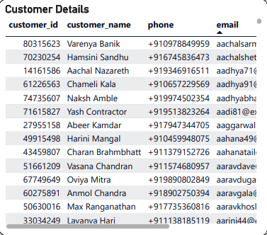
2️⃣1️⃣ Customer Details
Purpose: To provide customer-specific information such as ID, name, phone number, and email for operational or marketing reference.
Visual: Detailed table with columns: customer_id, customer_name, phone, email.
Insights:
Supports personalized communication and marketing campaigns.
Useful for customer service tracking, re-engagement, and segment-based targeting.
Can be used to identify frequent or VIP customers for loyalty programs.

Slide 28
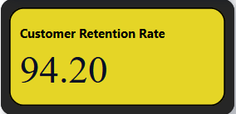
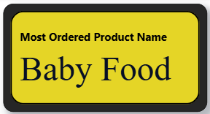
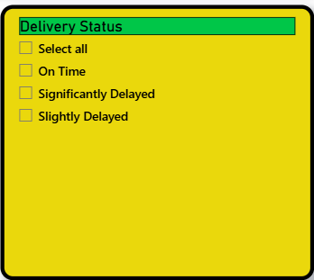
2️⃣2️⃣Customer Retention Rate
Purpose: To show how many customers return for repeat purchases.
Visual: KPI card showing “94.20” as the retention percentage.
Insights:
High retention rate (94.2%) indicates strong customer satisfaction.
Reflects effective engagement and loyalty management.
2️⃣3️⃣ Most Ordered Product
Purpose: Highlight the top product by total orders.
Visual:Highlight card: “Baby Food – Most Ordered Product”. .
Insights:
. Baby Food is the highest ordered item.
Indicates strong demand and should be prioritized for inventory.
2️⃣4️⃣ Delivery Status Filter
Purpose:. Filter delivery records by their status to review order timeliness
Visual:. Slicer box with four filter options: On Time, Slightly Delayed, Significantly Delayed, Select All.
Insights:Enables targeted analysis of delayed deliveries for efficiency gains.
Useful for evaluating logistics team performance and identifying delay causes.
Lets users quickly adjust dashboard visuals to focus on specific delivery issues.

Slide 29
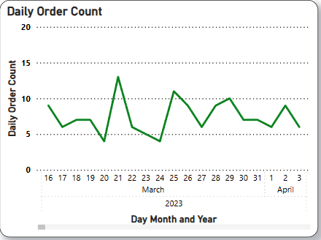
2️⃣5️⃣ Daily Order Count
Purpose: Show the daily count of orders placed over time.
Visual: Line chart — X-axis: Day, Month, Year; Y-axis: Daily Order Count.
Insights:
Order numbers fluctuate day-to-day, but generally stay steady.
Peak days highlight when extra staff or delivery slots may be needed.
Any sudden dips signal issues that may require immediate attention.

Slide 30
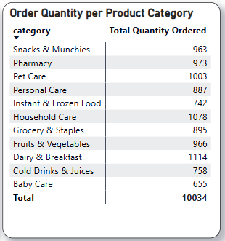
2️⃣6️⃣ Order Quantity per Product Category
Purpose: Display which product categories have the largest total order quantities.
Visual: Table showing categories alongside their total quantity ordered.
Insights:
Household Care, Pet Care, and Pharmacy top the list in order quantity.
Snacks & Munchies also demonstrate strong customer demand.
Useful for prioritizing category-specific promotions and inventory replenishment.

Slide 31
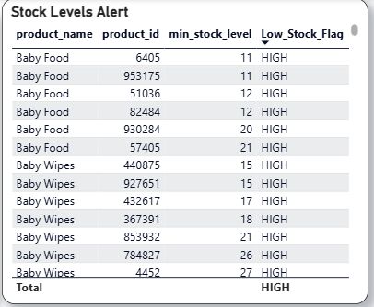
2️⃣7️⃣ Stock Levels Alert
Purpose: Spot products that have reached critical low stock.
Visual: Table listing each product name, ID, and a "HIGH" low stock alert flag.
Insights:
All items are marked "HIGH" for low stock.
The majority are Baby Food and Baby Wipes—fast-moving essentials.
Highlights an urgent need for restocking to prevent running out.

Slide 32
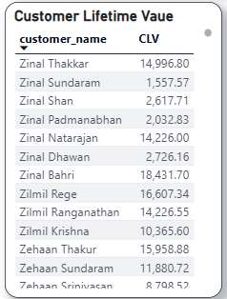
2️⃣8️⃣ Customer Lifetime Value (CLV)
Purpose: . Show the total lifetime value (CLV) of each customer.
Visual: Table listing customer names alongside their CLV.
Insights:
Customers with the highest CLV, such as Zilmil Rege and Zinal Bahri, are major revenue drivers.
Highlights which individuals contribute most to long-term business growth.
Enables targeted loyalty and retention efforts for top-value customers.

Slide 33
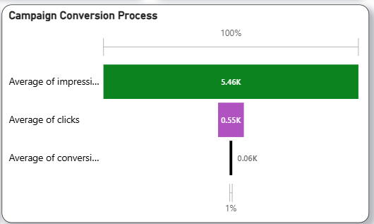
2️⃣9️⃣ Campaign Conversion Process
Purpose: Show how many impressions lead to clicks and eventual conversions.
Visual: . Funnel bar chart with steps: average impressions, clicks, and conversions.
Insights:
Starts with 5,460 impressions, narrowing to 550 clicks, then just 60 conversions.
Implies an overall conversion rate around 1%.
Useful for pinpointing where to improve ad targeting and creative content for better performance.

Slide 34
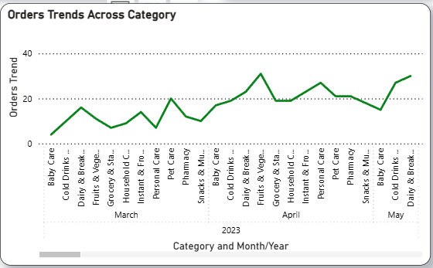
3️⃣0️⃣ Orders Trends Across Category
Purpose: Compare order trends and average order value across different product categories.
Visual
Dual line chart displaying trends for:
Order volume per category over time
Average order value by category
Insights:
. Baby Care, Snacks, and Cold Drinks maintain consistent demand.
Average order value differs from one category to another.
Helps design targeted offers and promotions suited to each category’s purchasing pattern.

Slide 35
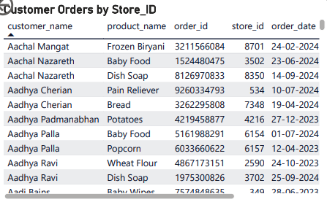
3️⃣1️⃣ Customer Orders by Store ID
Purpose: To see which customer bought which product, from which store, and when.
Visual: Table with customer_name, product_name, order_id, store_id, and order_date.
Insights:
Helps map order activity to specific stores.
Tracks which products are popular at different locations.
Supports store-level inventory and service planning.

Slide 36
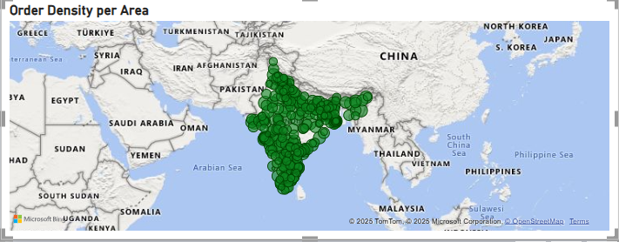
3️⃣2️⃣ Order Density per Area
Purpose: To visualize where most orders are placed geographically.
Visual: Map with pins showing order concentration.
Insights:
High density in major cities and states.
Useful for optimizing delivery zones.
Helps plan regional marketing or new hub locations.

Slide 37
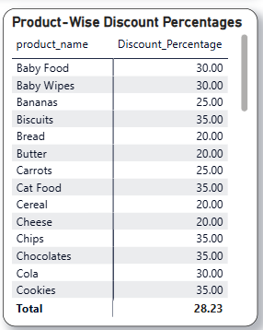
3️⃣3️⃣ Product-Wise Discount Percentages
Purpose: Show the discount percentage for each product.
Visual: Table listing product names alongside their discount percentages.
Insights:
Cat Food, Biscuits, and Baby Food have the highest discounts at around 30–35%.
The average discount is about 28%.
These insights help with making decisions on product pricing and promotional strategies.

Slide 38
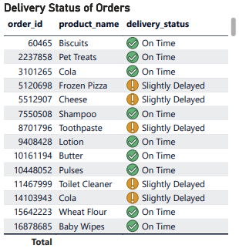
3️⃣4️⃣ Delivery Status of Orders
Purpose: To show the status of delivery for each product and order.
Visual: Table with order_id, product_name, and delivery_status.
Insights:
Most items marked On Time.
Frozen Pizza, Cheese, and Toilet Cleaner show slight delays.
Monitors delivery performance by product.

Slide 39
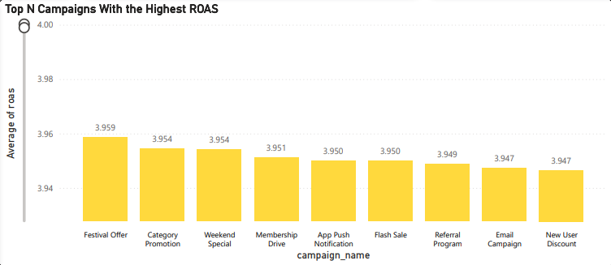
3️⃣5️⃣ Top N Campaigns with Highest ROAS
Purpose: Spotlight which marketing campaigns deliver the highest return on ad spend. Visual: . Column chart showing campaign names along the X-axis and their average ROAS on the Y-axis.
Insights:
. Festival Offer and Category Promotion yield the top returns, with ROAS around 3.95–3.96.
Referral and Email Campaigns are also strong performers.
Useful for deciding where to increase investment or repeat successful campaigns.

Slide 40
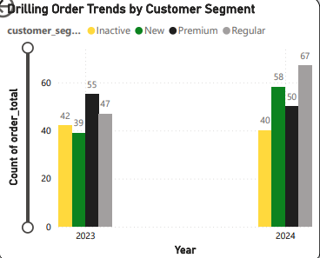
3️⃣6️⃣ Drilling Order Trends by Customer Segment
Purpose: Track changes in order volume for each customer segment over time.
Visual:
Clustered column chart — years on the X-axis, groups for Inactive, New, Premium, and Regular customers. Insights:
.Orders from Regular and New customers increased from 2023 to 2024, showing these groups are growing.
Inactive customer orders dropped slightly, suggesting better retention.
Useful for focusing marketing on specific customer segments with targeted strategies.

Slide 41
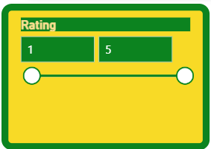
3️⃣7️⃣ Rating
Purpose: Show the selected rating value for quick scenario analysis or filtering.
Visual: Numeric scale or card highlights the current rating selection
Insights:
Reflects customer feedback for the chosen filter or segment.
Lets you see how service quality changes with higher or lower ratings.
Supports ongoing monitoring and improvement of service standards.

Slide 42
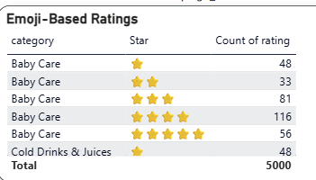
3️⃣8️⃣ Emoji-Based Ratings
Purpose: Display customer product and service ratings using star emojis.
Visual: Table showing categories, star ratings, and number of reviews.
Insights:
Baby Care mostly has high ratings (4–5 stars), indicating strong satisfaction.
Cold Drinks & Juices received some low ratings (1 star), signaling areas for improvement.
Highlights where product quality is good and where it needs attention.

Slide 43
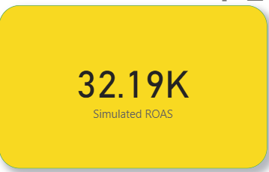
3️⃣9️⃣ Simulated ROAS
Purpose: Test potential Return on Ad Spend (ROAS) in different scenarios
Visual: . KPI card showing a simulated value—32.19K ROAS.
Insights:
Illustrates possible ROI if ad budgets are adjusted.
Helps managers evaluate the impact of changing their spend.
Supports financial planning and future forecasts.

Slide 44
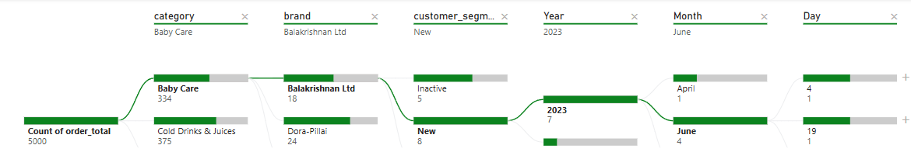
4️⃣0️⃣ Tree Visualization of Product Sales
Purpose:
Break down product sales across various dimensions for granular analysis. Visual: Multi-level tree or Sankey diagram showing sales by category, customer segment, year, month, and day.
Insights:
. Pet Care records 398 total orders, detailed by segment and time.
The New customer segment drives most of these orders.
The structure allows easy drill-down to trace sales by each criteria for deeper insights.

Slide 45
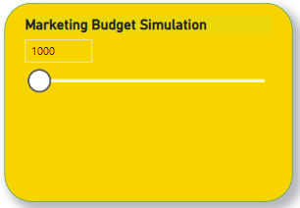
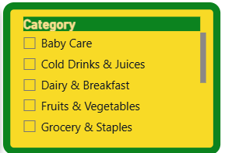
4️⃣1️⃣Marketing Budget What-If
Purpose: Simulate changes in marketing budget to see the effect on key metrics.
Visual: Slider or input box to adjust the budget amount
Insights:
Lets you test how increasing or decreasing spend impacts ROAS.
Helps optimize where to allocate advertising budget.
Useful for scenario planning and financial decisions.
4️⃣2️⃣ Category Filter Panel
Purpose: Allow users to filter data visuals by product category
Visual:
Checklist with options like Baby Care, Snacks, Pet Care, and more Insights:
Lets you focus analysis on specific product categories.
Supports customized dashboard views for different needs.
Makes it easy to compare how each category is performing.

Slide 46
Key Findings
1. Order Peaks Indicate Seasonal Trends Order volume surged in August and May 2023, pointing to clear periods of increased customer activity and potential for targeted seasonal marketing. 2.Solid Delivery Rates, But Room for Optimization More than 70% of orders arrive on time, but nearly a third face delays (mostly minor), signaling a chance to fine-tune delivery routes or time slots. 3.Significant Product Damage in Certain Categories Items such as Toilet Cleaner and Detergent show damage rates exceeding 20%, highlighting the need for improved packaging or logistics handling. 4.Marketing ROI Varies Sharply Across Campaigns Referral Programs and Festival Offers deliver standout returns (ROAS above 3.9), whereas other campaigns lag, indicating advertising budgets should be refocused on top performers. 5.High-Value Customer Base Identified Customers like Aadhya Cherian have customer lifetime values over ₹28,000, offering an opportunity for premium segment targeting and tailored retention programs.

Slide 47
Conclusion
By using Power BI to unify data from various sources, I gained valuable clarity into customer habits, delivery efficiency, marketing returns, and inventory status. The resulting dashboard transforms complex data into straightforward, actionable insights. How This Drives Better Decisions: Operations: Pinpoint and address hurdles in the delivery process for smoother fulfillment. Marketing: Channel resources toward campaigns that consistently deliver strong returns. Inventory: Minimize product losses and keep stockouts at bay for smoother supply. Customer Management: Recognize and reward high-value customers to enhance loyalty and satisfaction. Strategic Planning: Empower decisions rooted in real data insights rather than guesses or assumptions.
GITHUB Link → https://github.com/indra6945/powerBI_blinkit_dataset

Slide 48


Thank You!

